Slide 1

Apps Ideas

Slide 2

WorkoutMates
Purpose: Motivate users to exercise a certain amount of time each week.
Features:
Users can select a virtual pet or plant as their workout buddy.
The app tracks users' workouts and the calories they burn.
Workout buddies are rewarded based on users' contributions at the end of the day.
Users can collect virtual medals when they reach milestones.
Includes a community feature where people can share the appearance of their workout buddy.

Slide 3
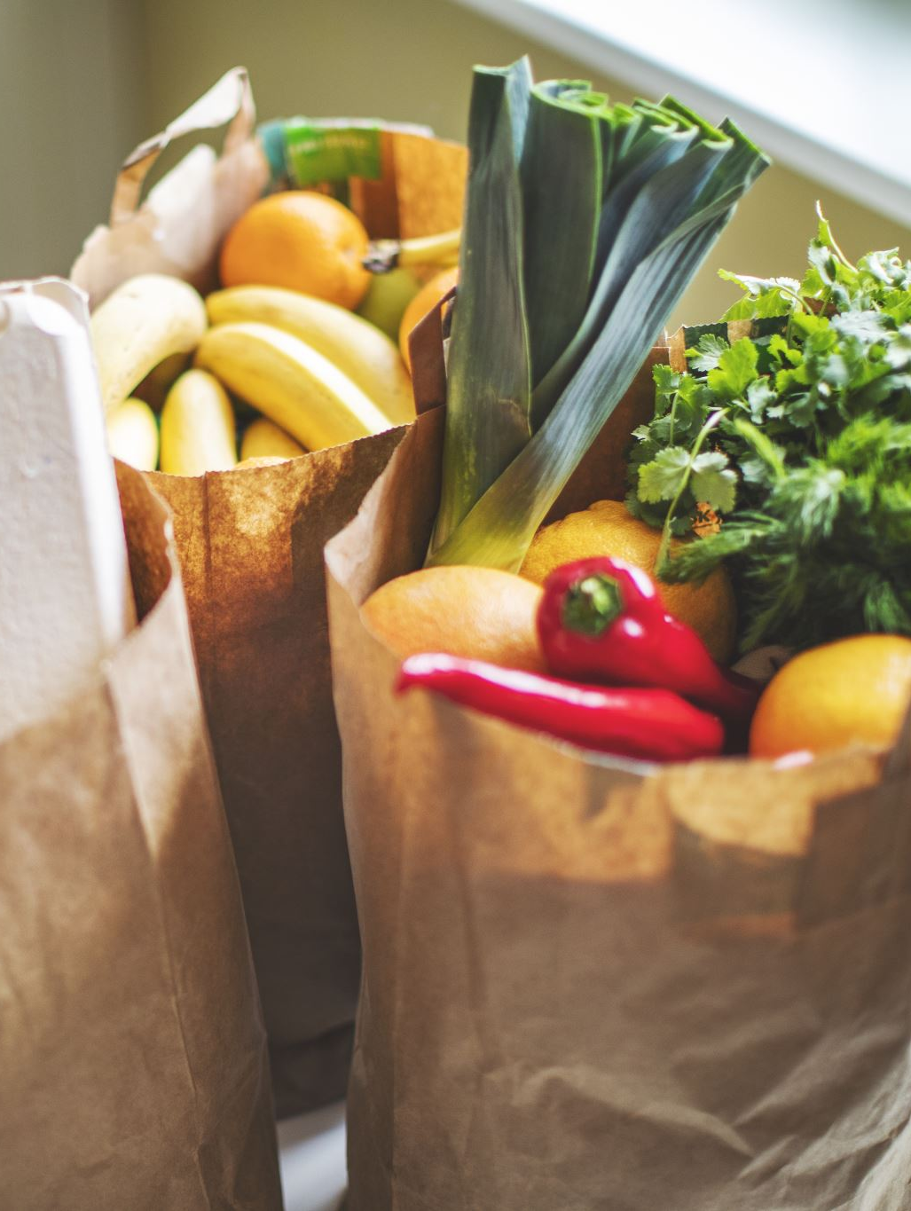
GerocerysFinder
Purpose: Help users find deals and discounts at local grocery stores.
Features:
Feeds discounts found in local grocery stores.
Gathers all grocery information so users don’t have to check each store’s app to find the best deals.
Allows users to place orders via phone for in-store pickup or delivery.

Slide 4

DailyPainter
Purpose: A creativity-boosting app to allow users to create drawings every day.
Features:
Users can do a five-minute drawing every morning when they wake up.
Users can draw whatever comes to their mind or what they dreamed of.
The app will rewind all the drawings at the end of the week, month, and year.

